Slide 1
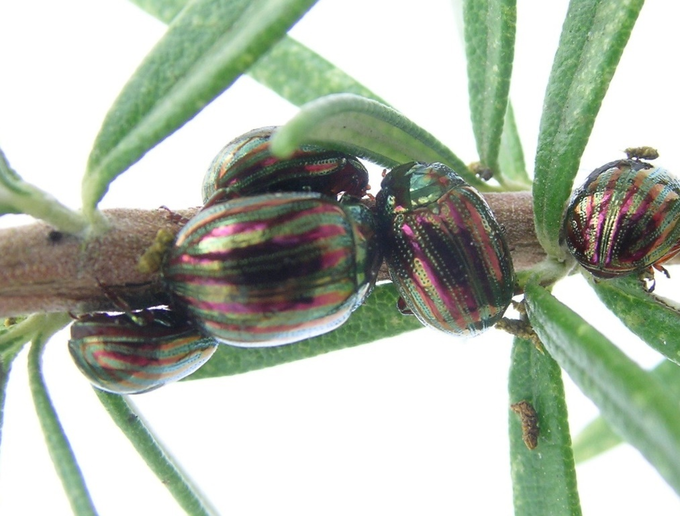



Climate change and garden invertebrate fauna
Andrew Salisbury - Principal Entomologist
@andrewsalisbur2

Slide 2
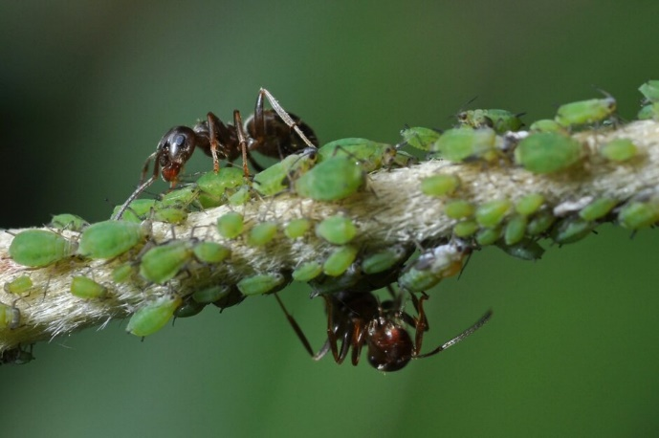
Outline
  Invertebrate declines
  Climate change
  What is happening?
  Climate change?
  What might happen
  Summary

Slide 3
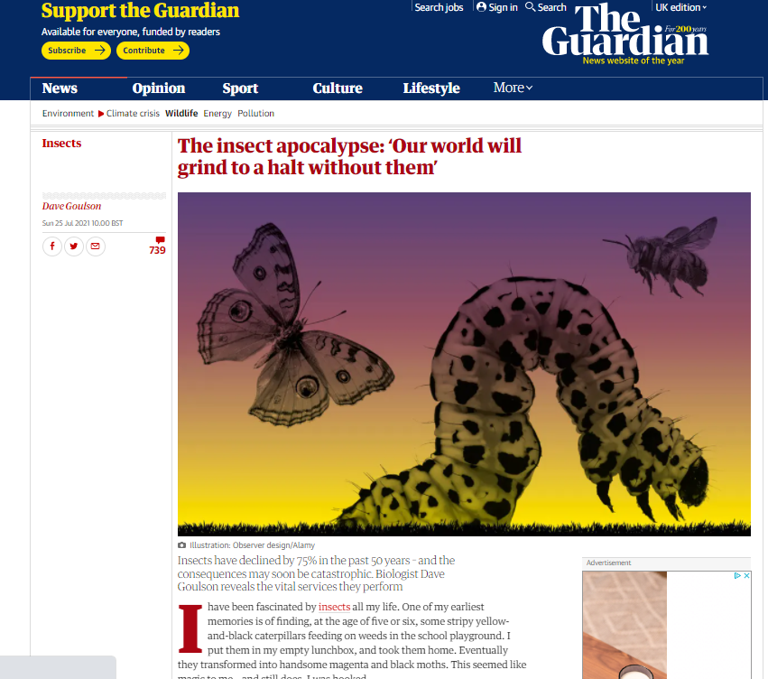

Invertebrate declines
We don’t know much!

Slide 4
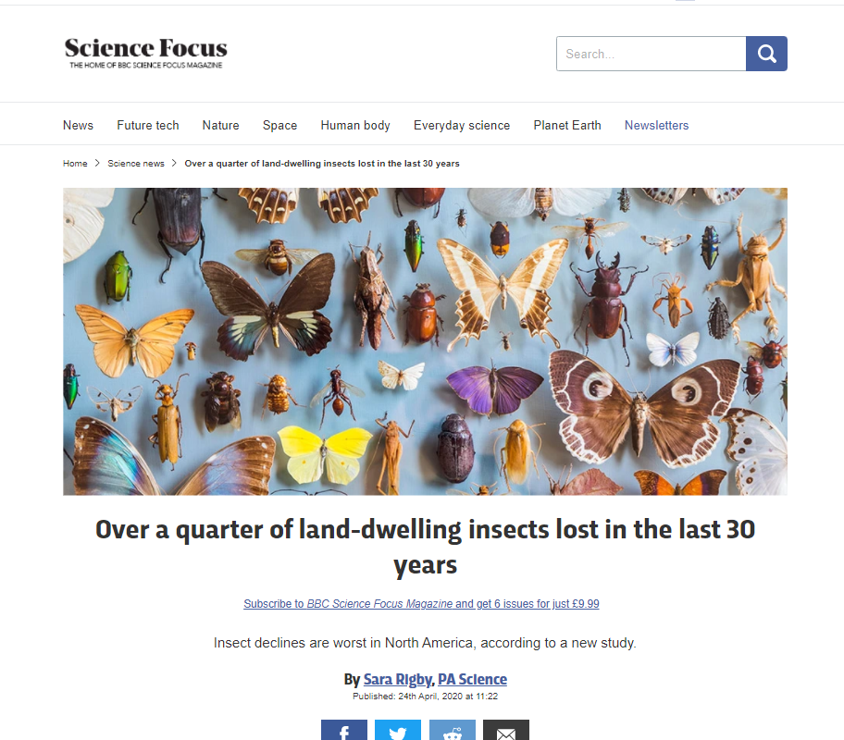
Invertebrate declines
We don’t know much!

Slide 5
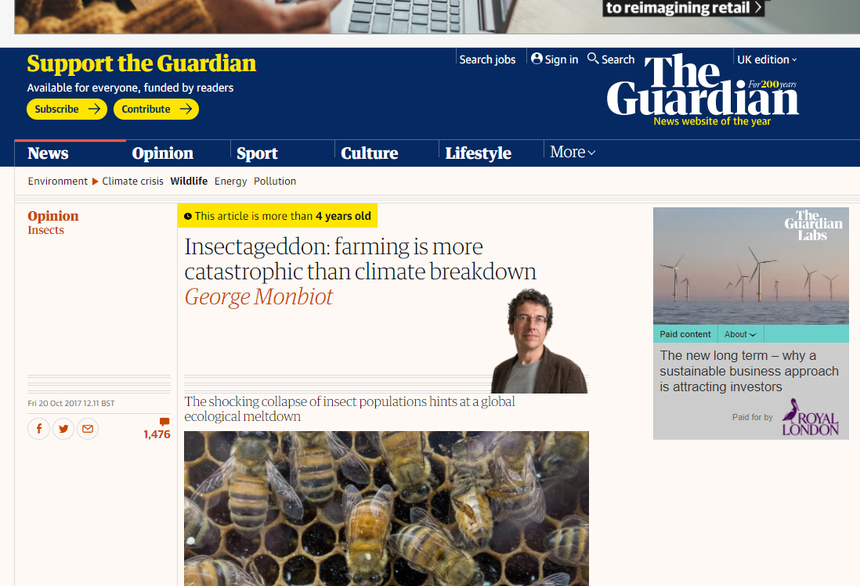
Invertebrate declines
We don’t know much!

Slide 6
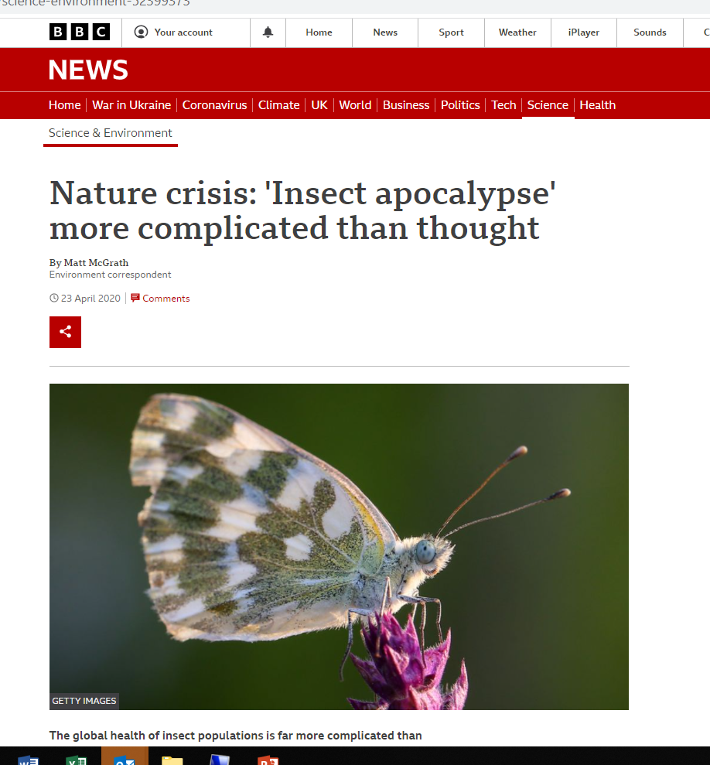
Invertebrate declines
We don’t know much!

Slide 7
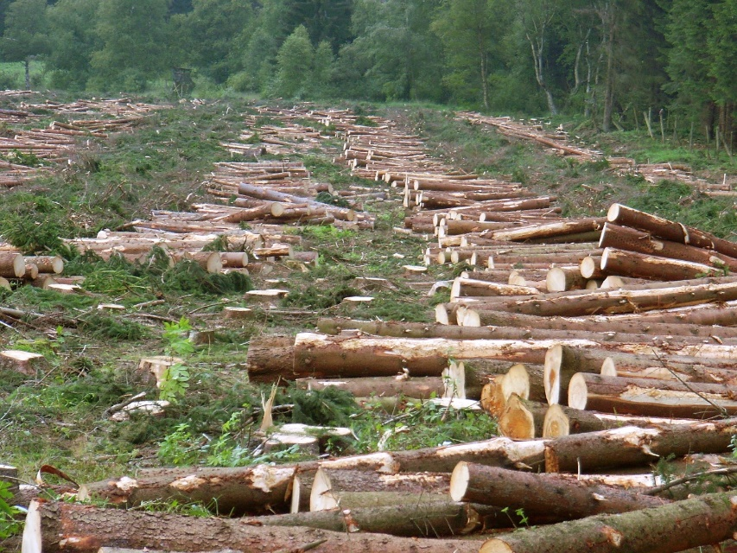
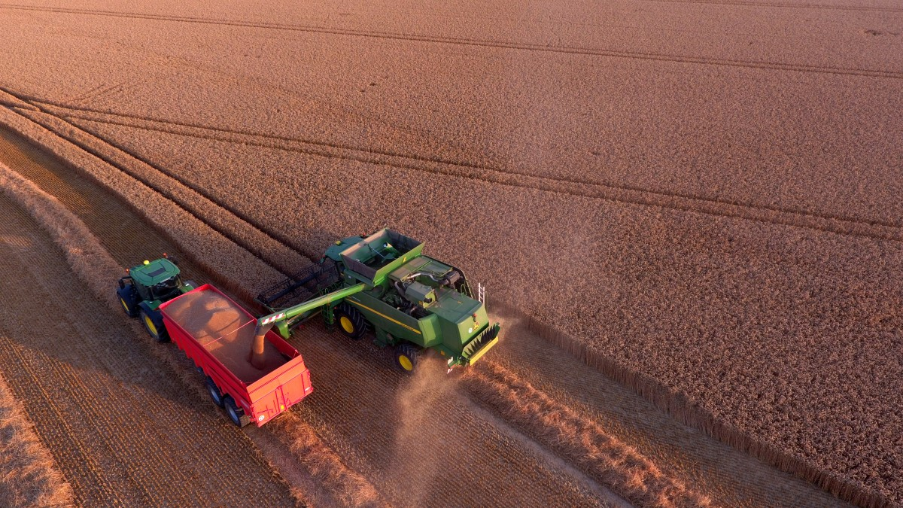
Invertebrate declines
Habitat loss/ land use change including
agricultural intensification/ pesticides

Slide 8
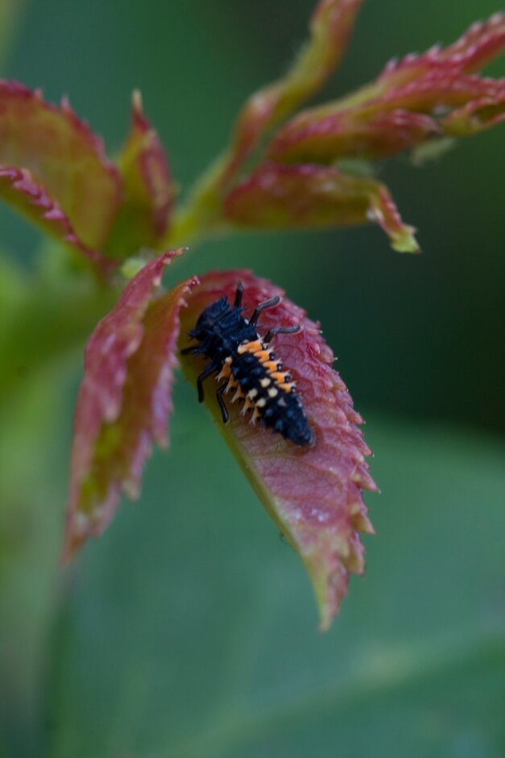
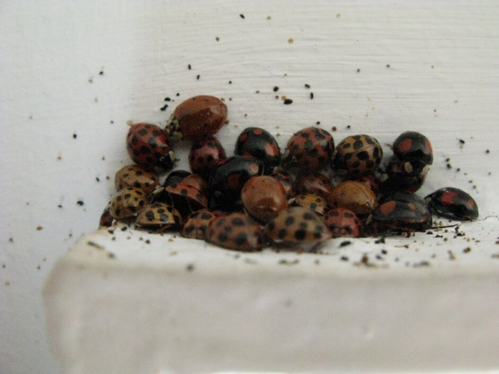
Invertebrate declines
‘Invasive’ species

Slide 9
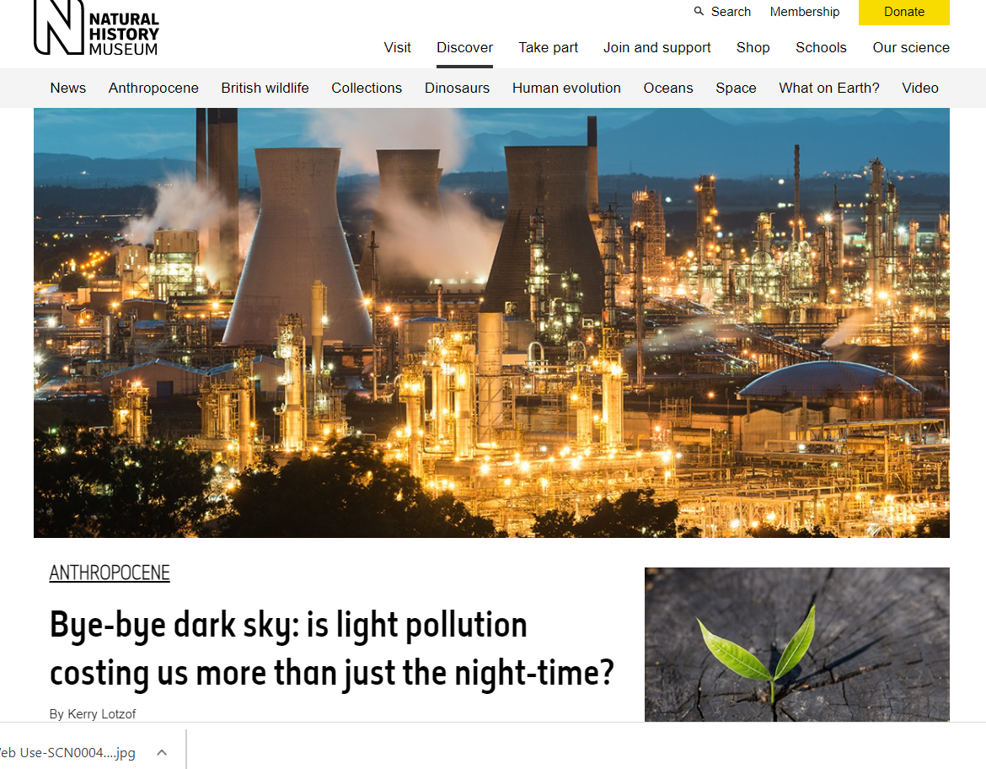
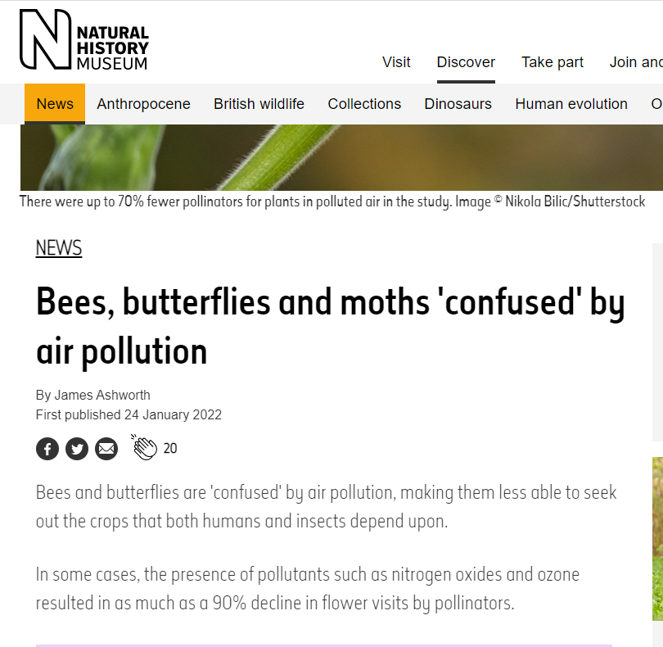
Invertebrate declines
Pollution

Slide 10
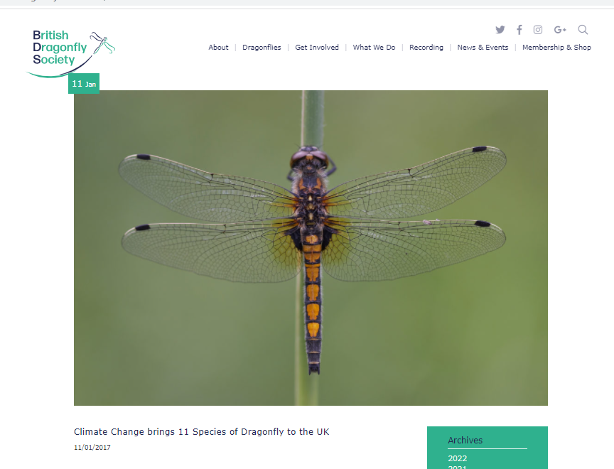
Climate Change: What is happening?
Dragonflies and Damselflies
Dragonflies bucking the trend of declining species in Britain and Ireland?
11 new* species to UK since 1995 (now 56)
> 40% increased since 1970, 11% have declined
Emperor – spread from England and south Wales, Ireland 2000, Scotland 2003
*invasive?
Taylor et al. 2021. State of Dragonflies 2021 in Britain and Ireland. BDS 2021

Slide 11
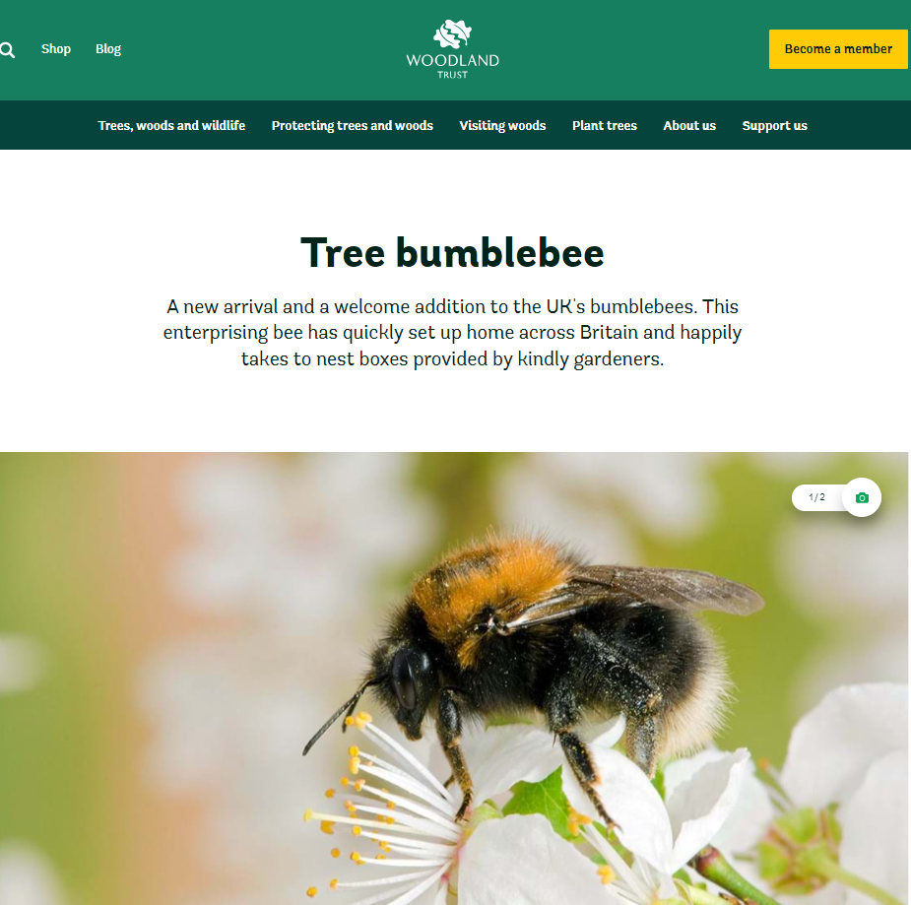
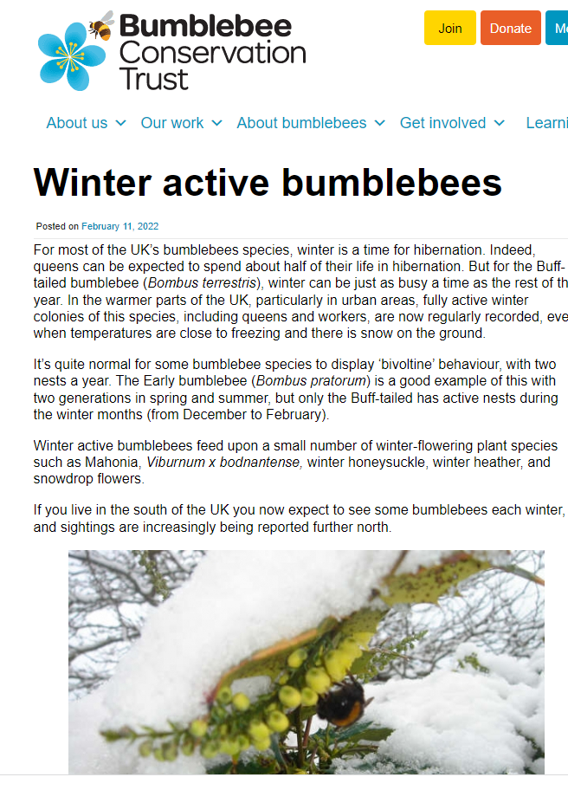
What is happening?
Bumblebees
New species
Extended seasons
Population sinks or more generations?

Slide 12
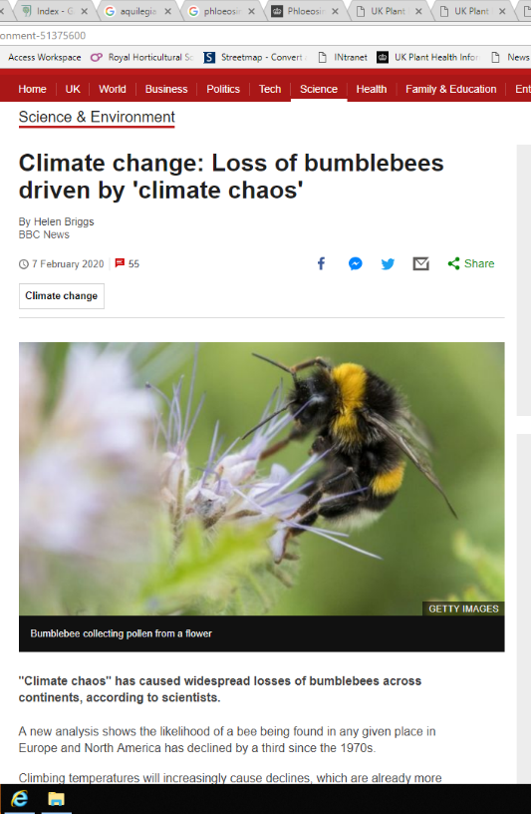
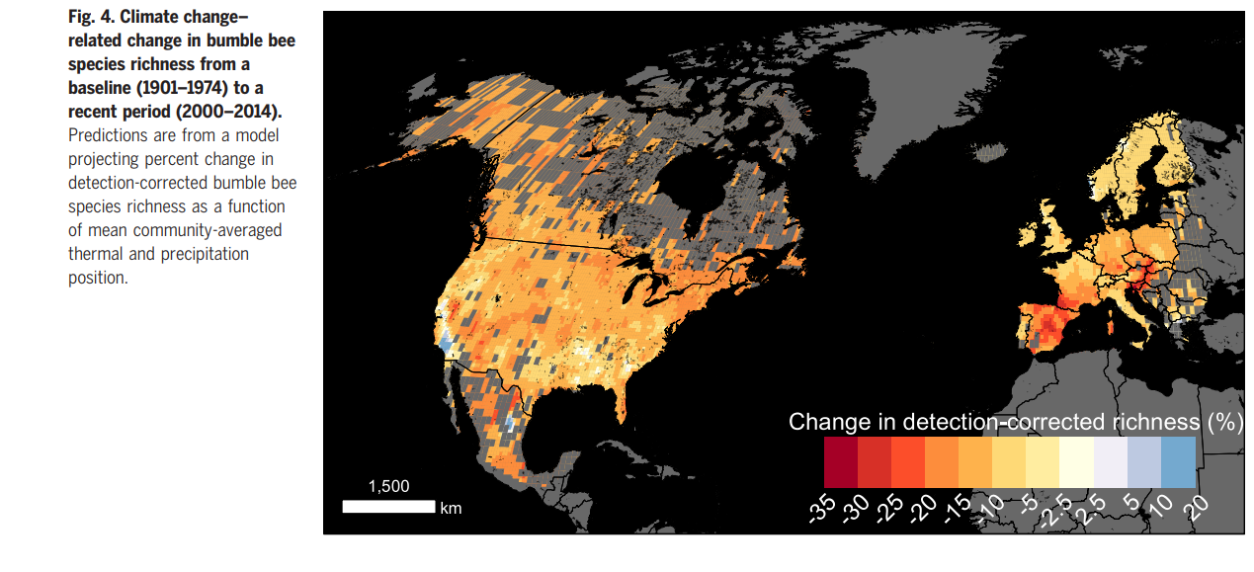
What is happening?
Bumblebees
Moving north
Suitable climate areas for ‘occupancy’ declining – temperature and precipitation
Plus extreme* events
Soroye et al. 2020 Climate change contributes to widespread declines among bumble bees across continents. Science 367:685-688

Slide 13
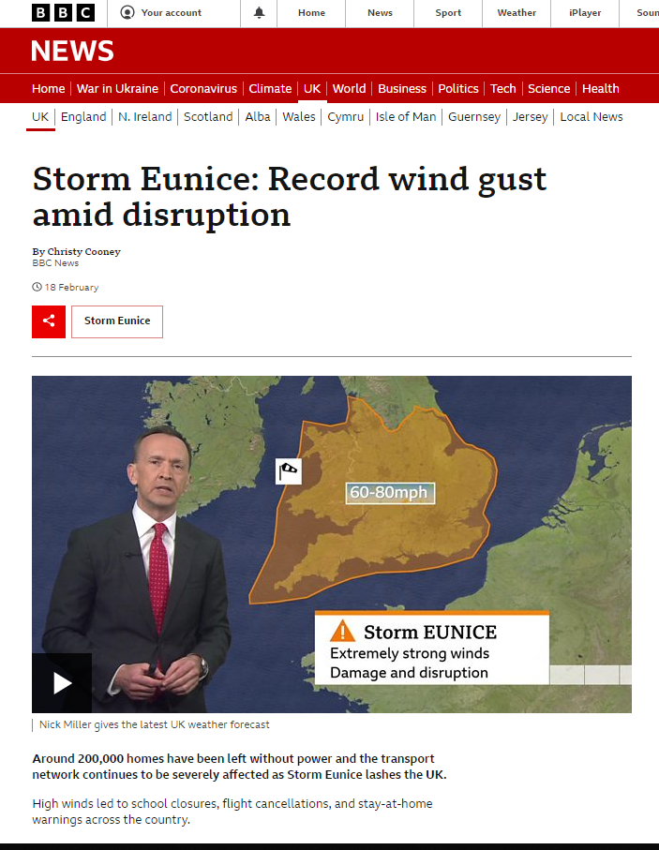

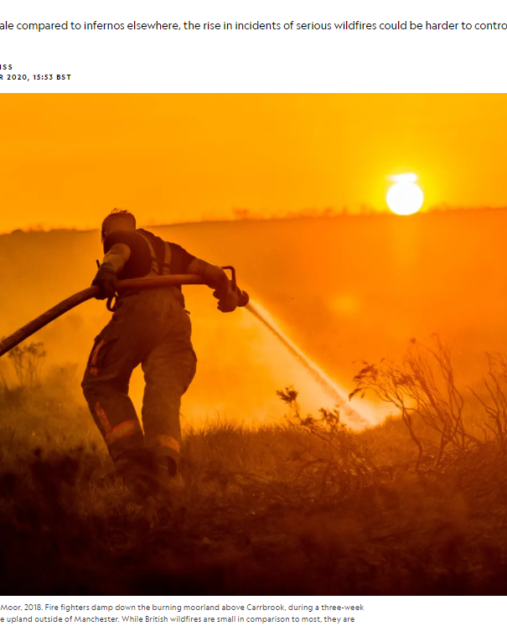

What is happening?
*Extreme events

Slide 14
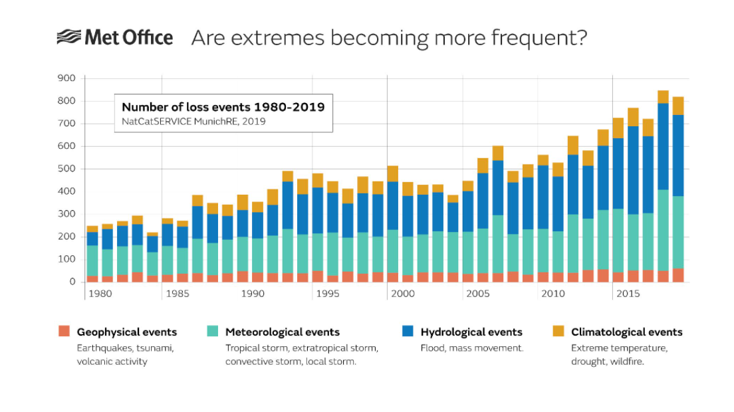
What is happening?
*Extreme events
https://www.metoffice.gov.uk/weather/climate/limate-and-extreme-weather

Slide 15
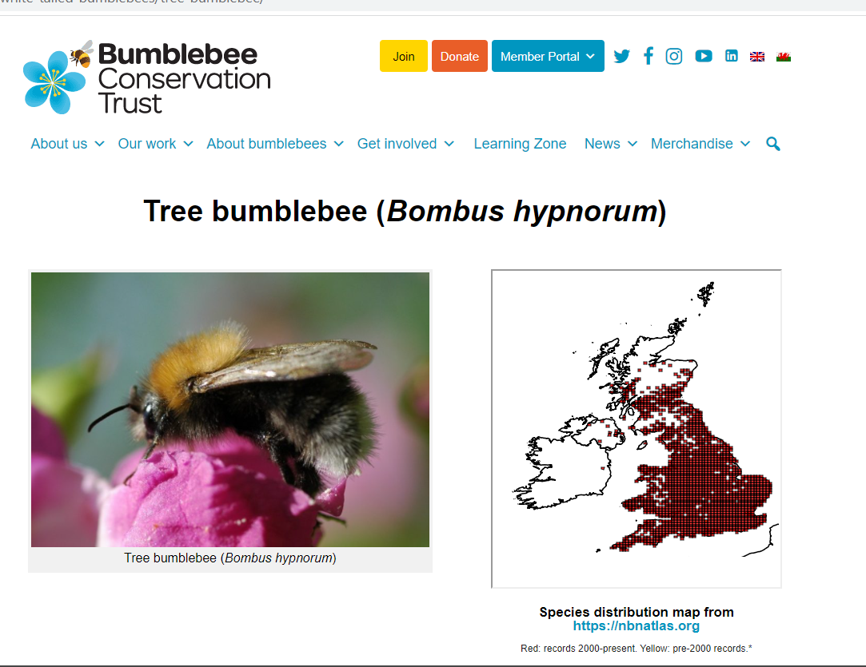
What is happening?
Bumblebees –the future?
Restricted to Northern Scotland ?

Slide 16
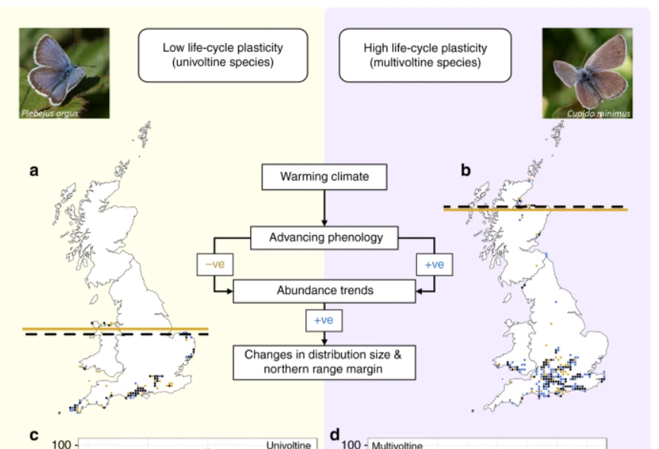
What is happening?
Butterflies – emerging earlier
More generations = moving northwards faster
Silver studied blue
Small blue
Macgregor, et al. 2019 Climate-induced phenology shifts linked to range expansions in species with multiple reproductive cycles per year. Nat Commun 10, 4455.

Slide 17
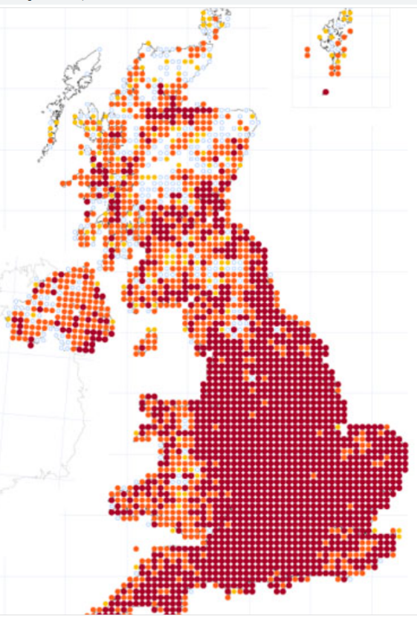
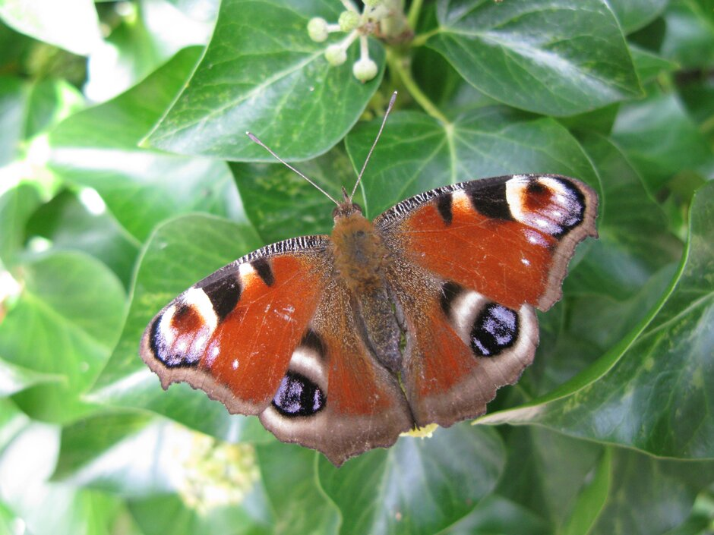
What is happening?
Butterflies
Generalists (with stable populations) moving north
Mair 2014 Abundance changes and habitat availability drive species’ responses to climate change. Nature Clim Change 4:127–131.
https://butterfly-conservation.org/butterflies/peacock

Slide 18
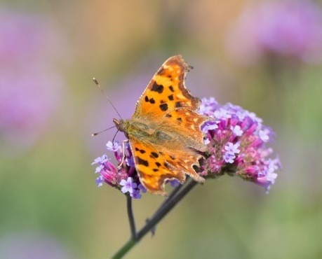
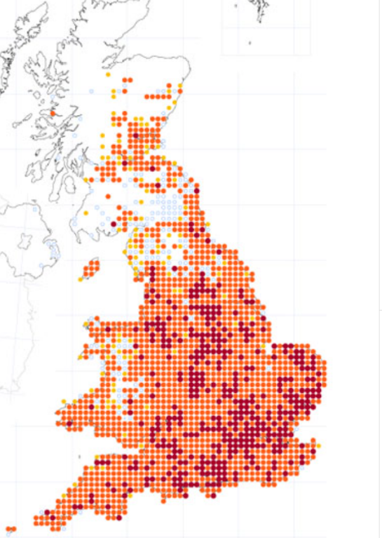
What is happening?
Butterflies
Generalists – host range shifts
Braschler & Hill 2007. Role of larval host plants in the climate-driven range expansion of the butterfly Polygonia c-album. J. Animal Ecology 73: 415-423
butterfly-conservation.org/butterflies/comma

Slide 19
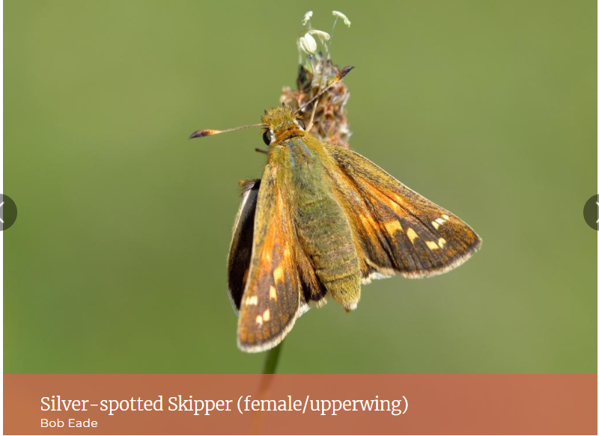
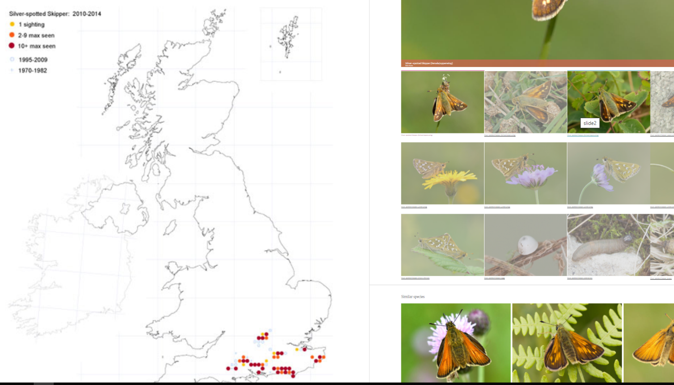
What is happening?
Butterflies
Specialists – unable to expand fragmented habitat
May need help - translocations
https://butterfly-conservation.org/butterflies/silver-spotted-skipper
Mairet al. 2014 Abundance changes and habitat availability drive species’ responses to climate change. Nature Clim Change 4:127–131.

Slide 20
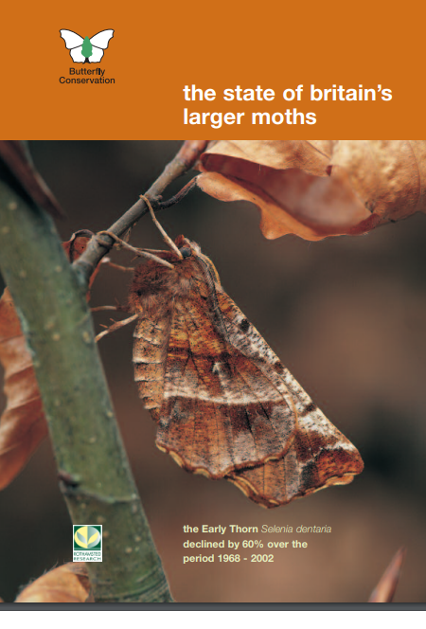
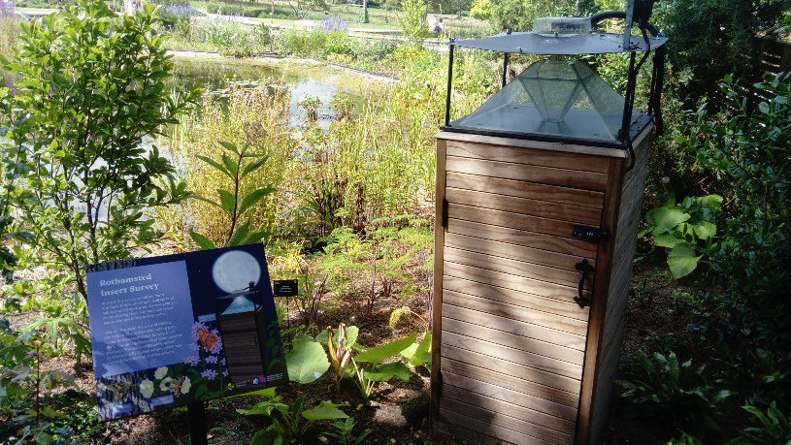
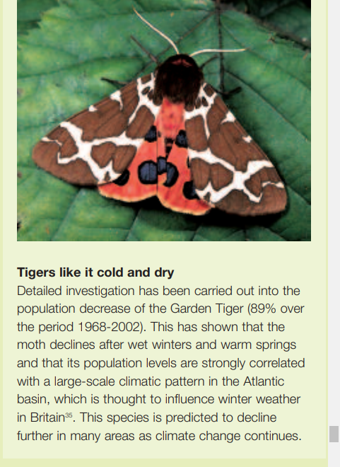
What is happening?
Moths
Warm winters lower caterpillar survival of garden tiger moth
Conrad, et al. 2002. Long-term decline in abundance and distribution of the garden tiger moth (Arctia caja) in Great Britain. Biological Conservation. 106: 329-337.

Slide 21
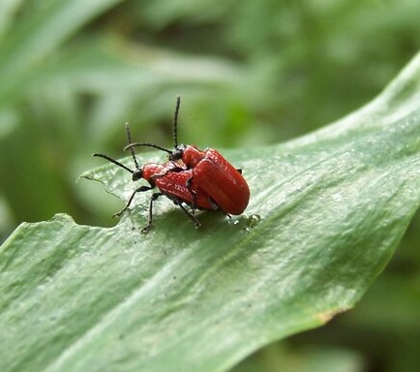
Climate change?
Lily beetle Lilioceris lilii
1990
2019

Slide 22
Climate change?
Lily beetle Lilioceris lilii
2002
2019
Plant movements ?

Slide 23
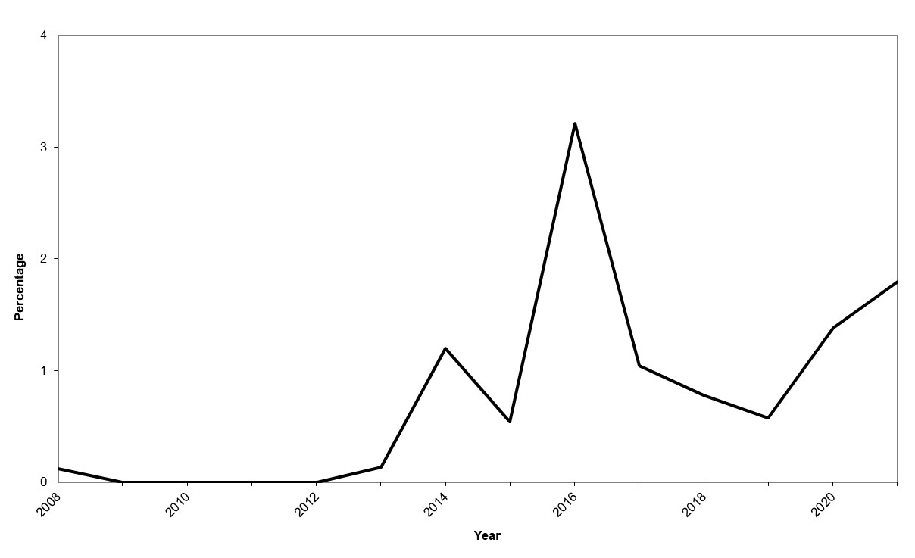
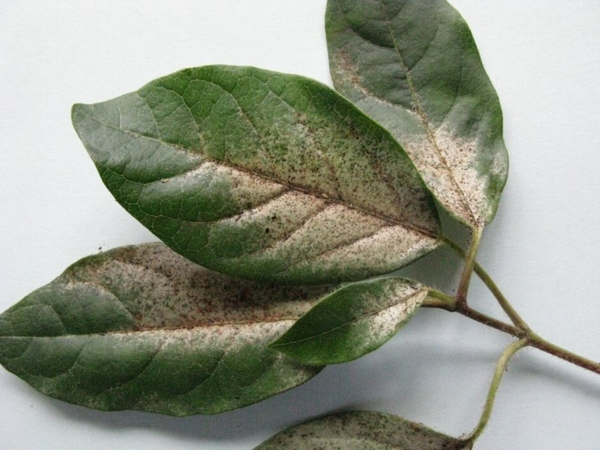
Climate Change?
Glasshouse thrips Heliothrips haemorrhoidalis
Glasshouse thrips enquiries as a percentage of entomology enquiries received by RHS Gardening Advice (2008 to 2021).
Heat islands?

Slide 24
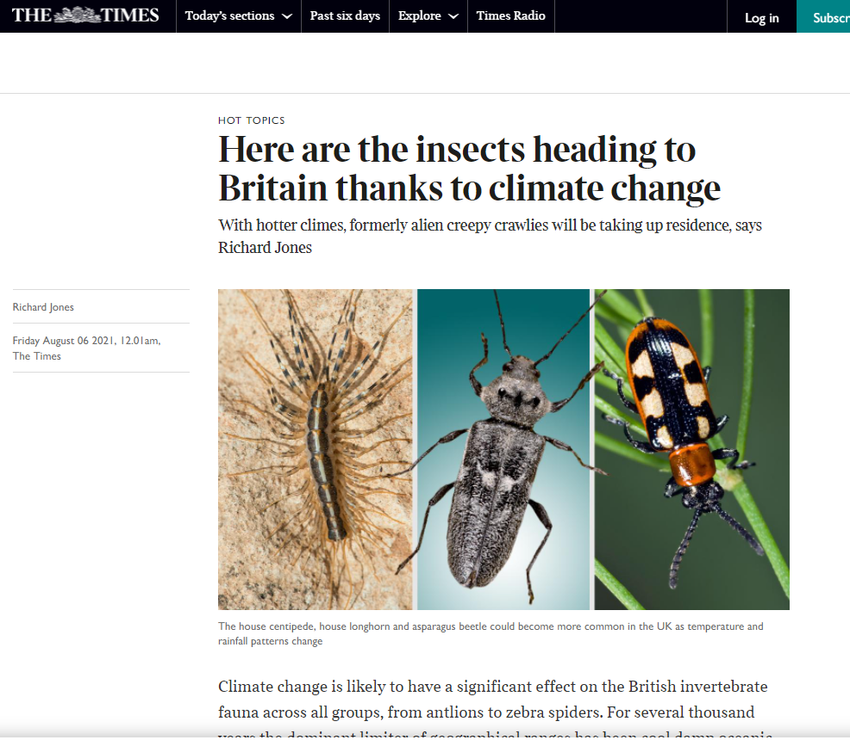
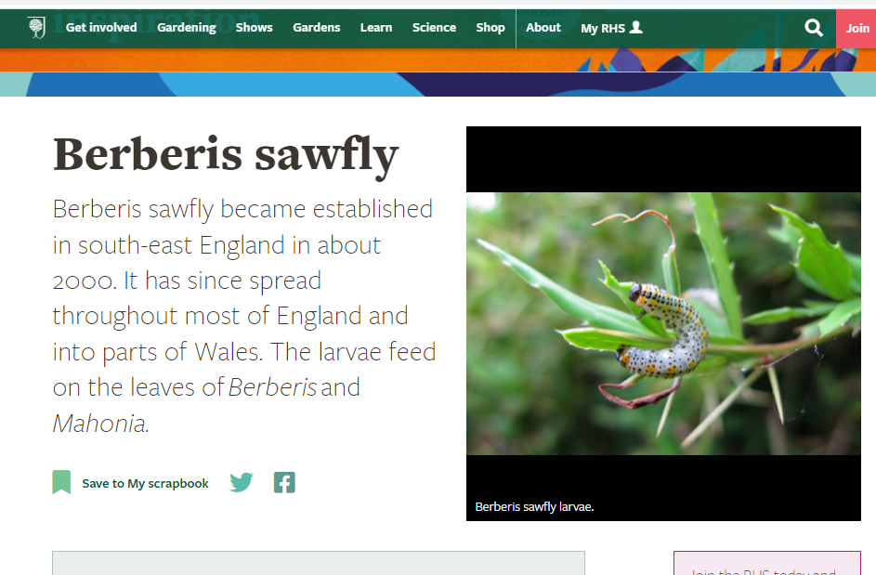
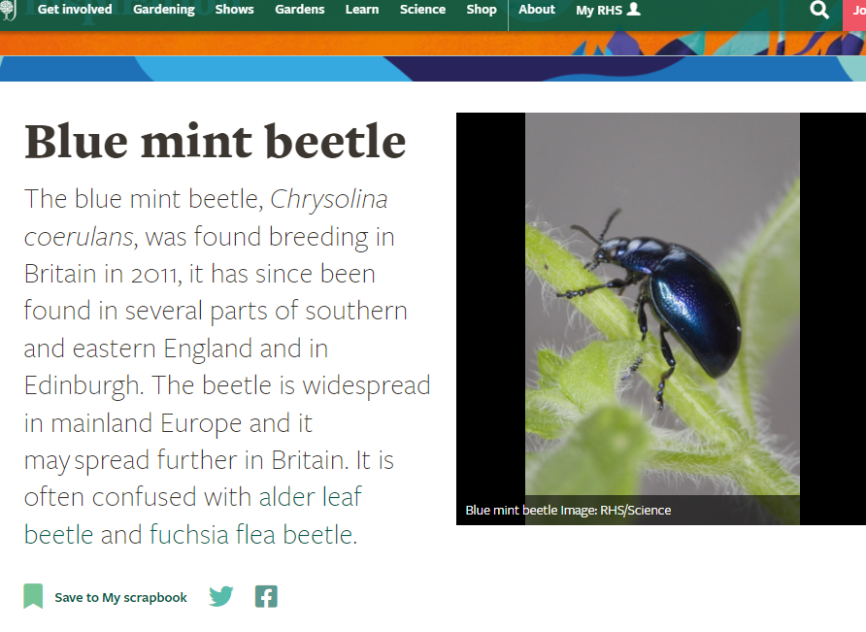
Other effects
New arrivals – ‘introductions’

Slide 25
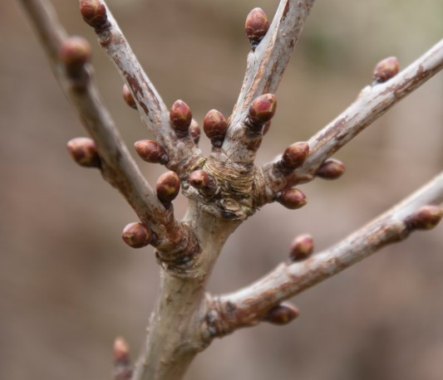
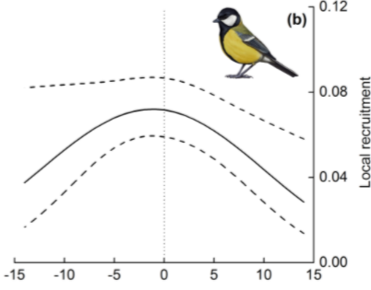
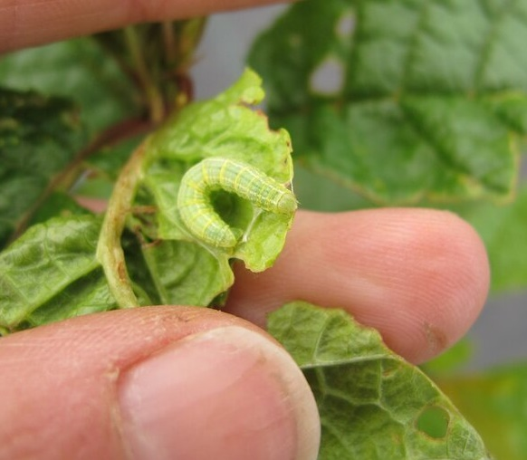
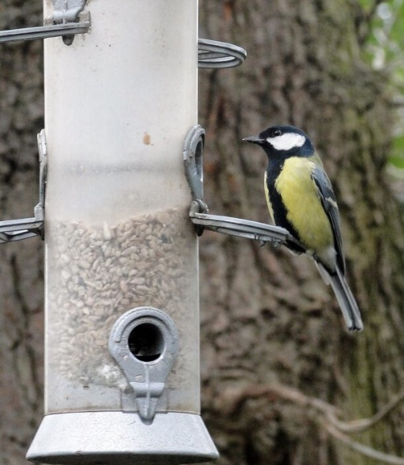
Other effects
Phenological* mismatch – nesting birds
The synchrony of three things
*Occurrence of cyclic and seasonal natural phenomena, in relation to climate and plant and animal life
Bud burst
Caterpillar egg hatch
Bird egg hatch
Pakanen et al. 2016 Different Ultimate Factors Define Timing of Breeding in Two Related Species. PLoS ONE 11: e0162643. doi:10.1371/journal. pone.0162643

Slide 26
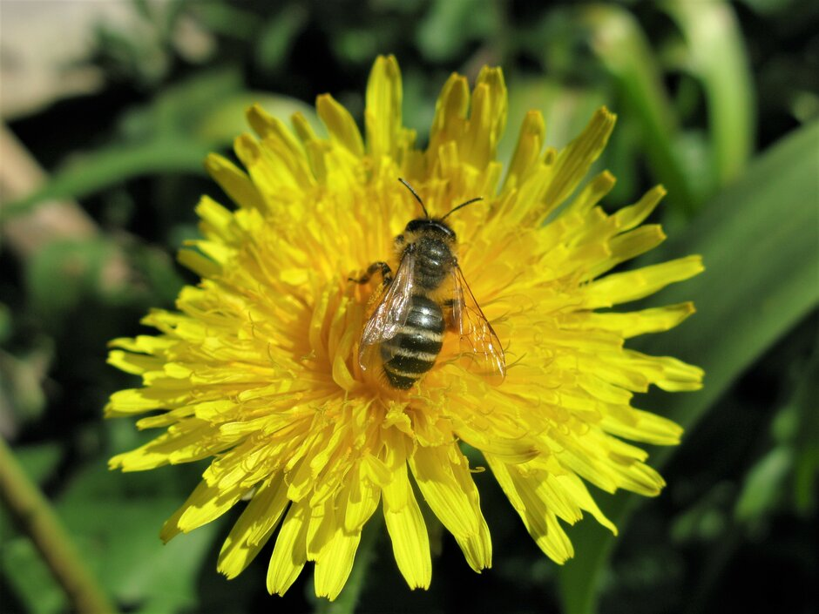
Other effects
Pollinator mismatch
May affect very specialist – e.g. orchid pollinators
Robbirt et al. 2014 Potential Disruption of Pollination in a Sexually Deceptive Orchid by Climatic Change Current Biology, 24: R1133-R1135

Slide 27
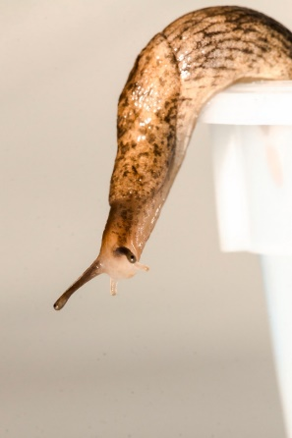
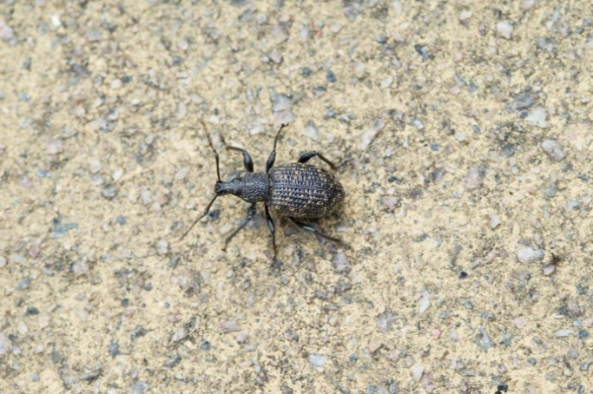
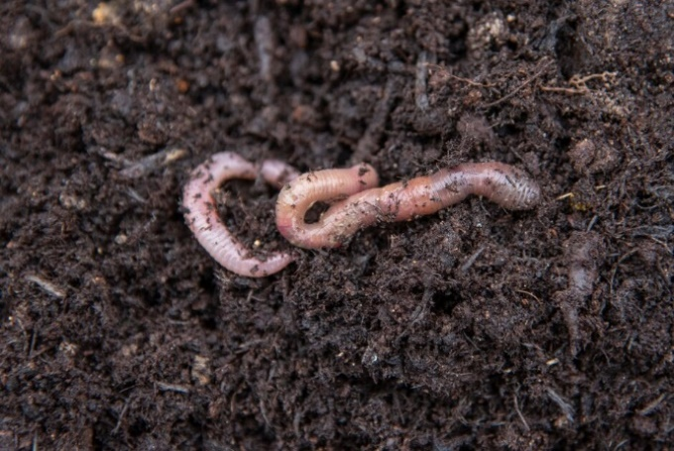
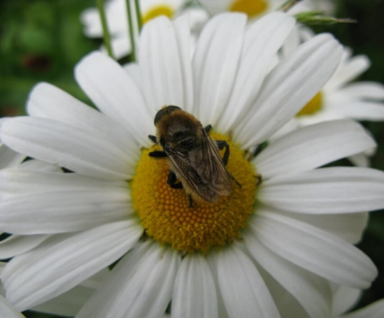
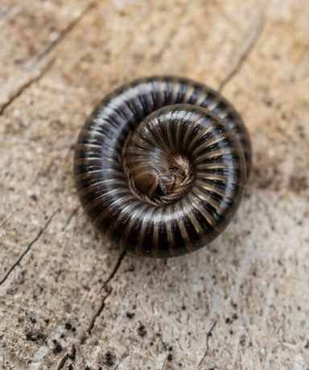
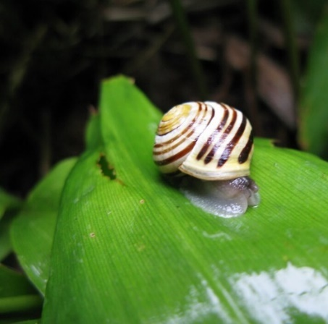
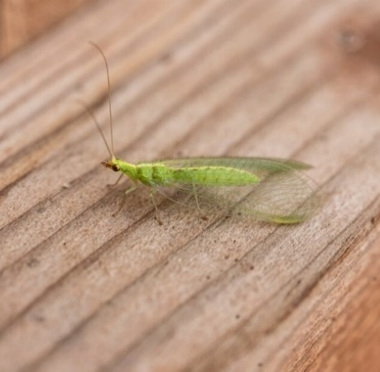
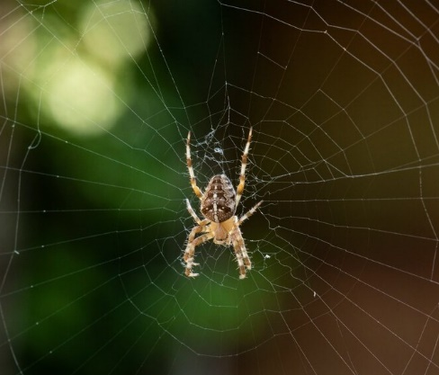

Summary
But – all the other insects and (garden) fauna?

Slide 28

Summary
Moving north and higher altitude
Earlier activity
Extremes
Habitat fragmentation
Changes in biology - including phenology (mismatches) and host range shifts
Generalists may become more common, lower ecological resilience
Long term effects of climate change negative and yet to kick in!

Slide 29


Summary
Effects of climate change yet to be realised!
Chris Thomas FRES
“If the current rate of change keeps up, it will suffice to rearrange every biological community on earth within a couple of centuries. Fundamental biological change is taking place, yet we hardly mention it.”
In Beebee 2018. Climate Change and British Wildlife

Slide 30

Thank you
P256 Beebee Chris T quotes
P279 Beebee models
P325 Beebee
Aphids

